Slide 1
A Survey of Peer-to-Peer Content Distribution Technologies
Stephanos Androutsellis-Theotokis and Diomidis Spinellis
ACM Computing Surveys, December 2004
Presented by
Sangyoun Paik

Slide 2
Defining Peer-to-Peer Computing
Peer-to-peer systems are distributed systems consisting of interconnected nodes able to self-organize into network topologies with the purpose of sharing resources such as content, CPU cycles, storage and bandwidth, capable of adapting to failures and accommodating transient populations of nodes while maintaining acceptable connectivity and performance, without requiring the intermediation or support of a global centralized server of authority.

Slide 3
Classification of P2P Applications
Communication and Collaboration
Distributed Computation
Internet Service Support
Database Systems
Content Distribution
Systems/infrastructures for the sharing of data between users
Napster, Gnutella, Freenet, Chord etc
the survey focuses on

Slide 4
P2P Content Distribution
P2P file exchange systems (e.g. Napster)
Classification of P2P Systems
P2P content publishing and storage systems (e.g. Freenet)
Routing and location (e.g. Chord, CAN, Pastry)
Classification of P2P Infrastructures
Anonymity
(e.g. Onion Routing)
Reputation Management (e.g. Eigentrust)

Slide 5
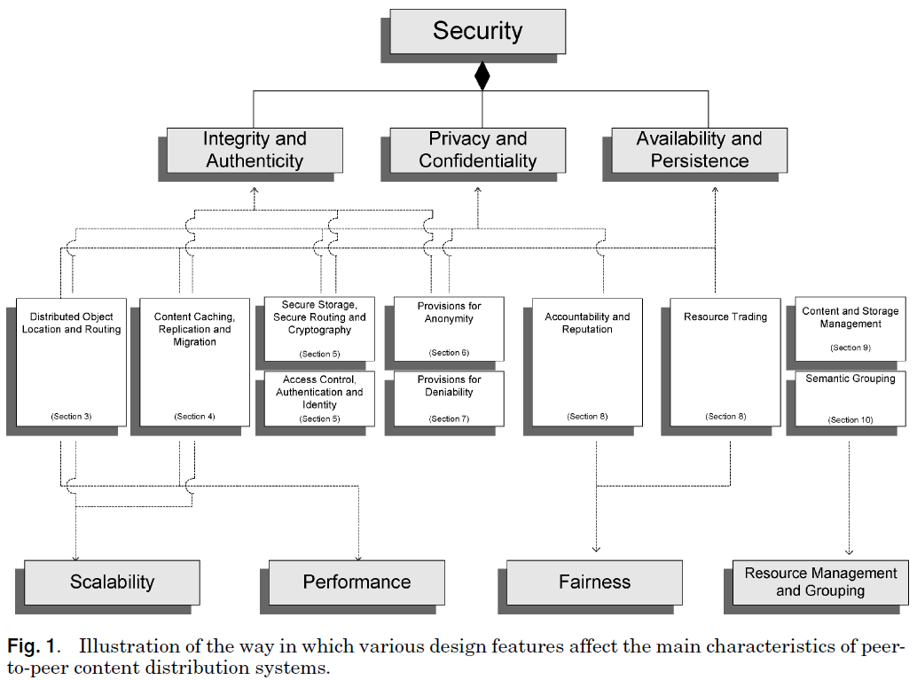
Analysis Framework

Slide 6
Analysis Framework
Characteristics of P2P content distributed systems
Design Decisions
Independent Design features

Slide 7
P2P Distributed Object Location and Routing
Overlay network – Network of peer computers and connections between them, formed on top of underlying physical computers
Distinguish Overlay network in terms of centralization and structure

Slide 8
Overlay Network Centralization
Various Degrees of Centralization
Purely Decentralized Architectures
Partially Centralized Architectures
Hybrid Decentralized Architectures
All nodes act as both servers and clients (servents)
Some nodes has a more important role (supernodes)
Supernodes do not constitue single points of failure
Central server facilitate end-to-end interaction
Single point of failure
Unscalable

Slide 9
Network Structure
Network is created
Deterministically or non-deterministically
Unstructured
Structured
Placement of content is completely unrelated to overlay topology
Appropriate for highly-transient node populations
Loosely Structured
Content is placed at specified locations
Exact-match queries
Hard to maintain with very transient node population
Location of content is not specified, but is affected by routing hints

Slide 10
Classification of P2P Content Distribution
 | Centralization
 | Hybrid | Partial | None
Unstructured | Napster | Kazza | Gnutella
Loosely Structured |  |  | Freenet
Structured |  |  | Chord, CAN, Tapestry

Slide 11
Unstructured Architectures
 | Centralization
 | Hybrid | Partial | None
Unstructured | Napster | Kazza | Gnutella
Loosely Structured |  |  | Freenet
Structured |  |  | Chord, CAN, Tapestry

Slide 12
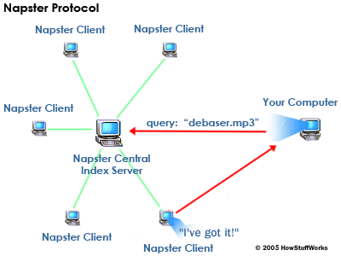
Unstructured Architectures
Hybrid Decentralized
e.g. Napster
Clients stores content
Clients connect to central server
Table of user connection
Table listing files each user holds
Advantage
Simple implementation
Locate files quickly
Disadvantage
Vulnerable to censorship
Unscalable
1. Send request to server
3. Return lists of matches
2. Server searches for matches
debaser.mp3
4. Download through direct connection
http://www.umkc.edu/is/security/p2p_explanation.asp

Slide 13
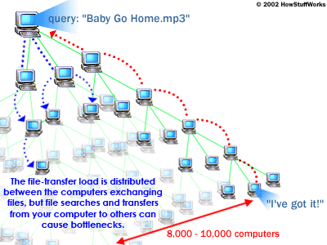
Unstructured Architectures
Purely Decentralized
e.g. Gnutella
Users connect to each other
No central Coordination
Application level protocol
Ping, Pong, Query, QueryHits
Time-to-live (TTL) in message header
Scalability issue
With TTL, messages can not reach
Without TTL, network swamped
1. Query message
2. QueryHit message
http://www.umkc.edu/is/security/p2p_explanation.asp

Slide 14
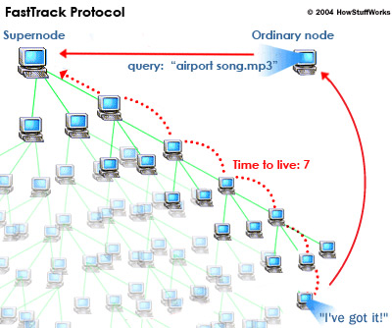
Unstructured Architectures
Partially Centralized
e.g. Kazza
Dynamically assign Supernodes
Supernodes index the files shared by peers connected to them
Advantage
Discovery time is reduced
Nodes are lightly loaded
Supernode servicing a subpart of network by Indexing/Caching
http://computer.howstuffworks.com/kazaa3.htm

Slide 15
Classification of P2P Content Distribution
 | Centralization
 | Hybrid | Partial | None
Unstructured | Napster | Kazza | Gnutella
Loosely Structured |  |  | Freenet
Structured |  |  | Chord, CAN, Tapestry

Slide 16
Structured Architectures - Freenet
Loosely Structured
knows which node is most likely to store certain content
Uses Chain Mode Propagation
local decision
avoid blindly broadcasting request message
File are identified by unique binary keys
Node maintains local data store and dynamic routing table
Messages
Node ID, Timeout(hops-to-live), Source ID, Destination ID
Message Types
Data insert
Data request
Data reply
Data failed

Slide 17
Structured Architectures - Freenet
Data Insert
Node calculates a binary key for the file
Node sends a data insert message to itself
If the key is not found
Node looks up the closest key in its routing table, and forwards
Files are placed at nodes possessing files with similar keys
If the key is found
Node returns the preexisting file
Data Request
If the node does not store the file
Forwards the request to its neighbor that is most likely to have the file
Forming a chain
If the node does store the file
Reply is passed back with the actual data

Slide 18
Structured Architectures - Freenet
Data Fail
A node receives a “data failed” messages
Selects the next best node and forwards
If all nodes failed, sends back “data failed” message to node that sent the request

Slide 19
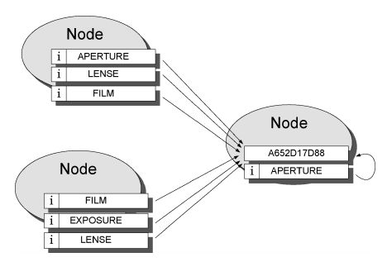
Structured Architectures - Freenet
Indirect Files
A special class of lightweight files
Named according to search keywords
Contain pointers to the real file
Multiple files w/ the same key
Properties
Nodes specialize in searching for similar keys
Nodes store similar keys
Similarity of keys does not reflect similarity of files
Routing does not reflect the underlying network topology

Slide 20
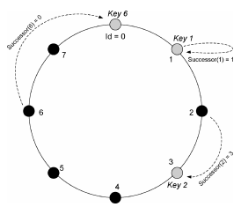
Structured Architectures - Chord
Mapping of file ID onto node ID
Node stores (key, data item)
Node is identified by keys
Key is assigned both to files and nodes
All node IDs are ordered in an identifier circle
Only routing information required is each node’s successor node

Slide 21
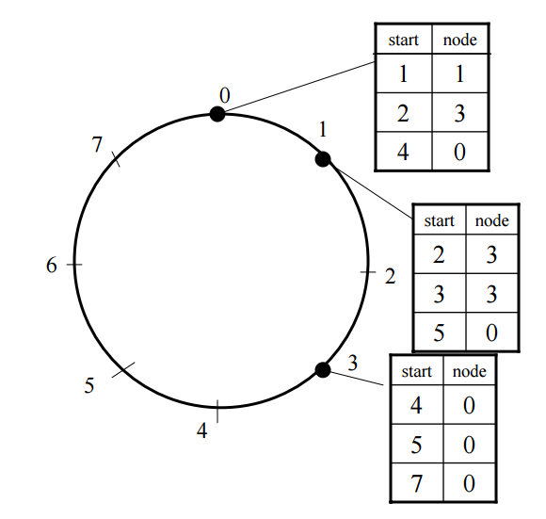
Structured Architectures - Chord
Additional Routing Information
finger table
Time required for lookups
O(N) -> O(logN)
Node 0 searches for id 5
Searches 5’s predecessor
Node is not 5’s predecessor
Scan finger table, search for the closest preceding finger
Node 3 is the first node that is between 0 and 5
Node 3 is 5’s predecessor
Node 3’s successor is returned

Slide 22
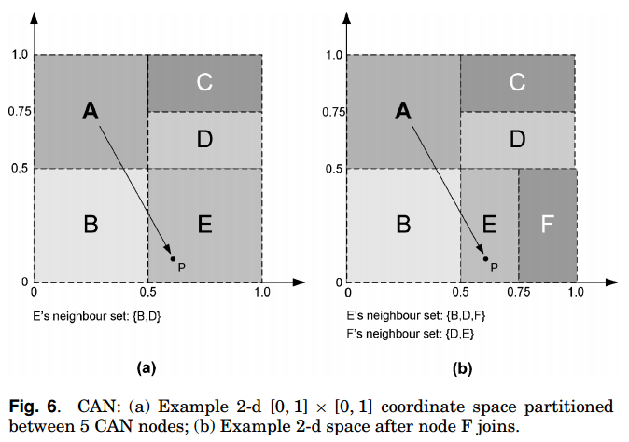
Structured Architectures - CAN
Hash Table
Maps file names to location
(key,value) pairs in the table
Support insertion, lookup, and deletion
Node stores a zone of the hash table
Cartesian coordinate space store (key K, value V) pairs
Key K is mapped onto a point P
Routing works by following the straight line path through Cartesian space.
A node Joins,
Allocated its portion by splitting the allocated zone of an existing node in half
A node leaves,
Hash table entry is handed over to one of its neighbors

Slide 23
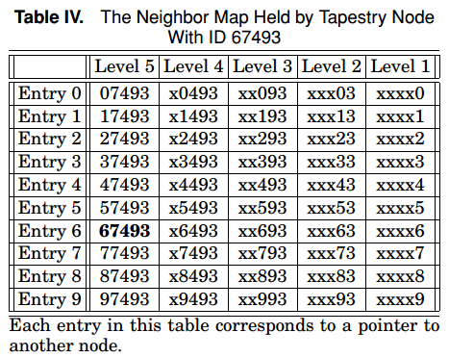
Structured Architectures - Tapestry
Network is self-organizing
Routing and Location Information is distributed among the network nodes
Plaxton mesh
Nodes take role of servers, routers and clients
Each node maintains a neighbor map
Level + Entry

Slide 24
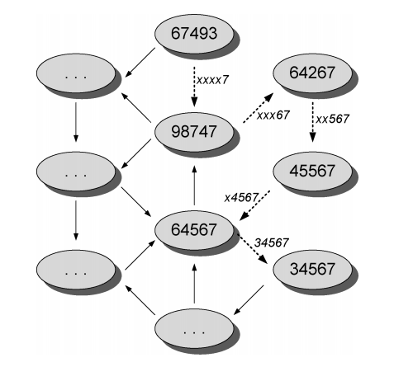
Structured Architectures - Tapestry
Messages route digit-by-digit
Example path taken by a message
node ID 67493 -> node ID 34567
Digits are resolved right to left
xxxx7->xxx67->xx567->x4567->34567

Slide 25
Structured Architectures - Tapestry
Plaxton mesh uses a Root node for each object
Provides a guaranteed node object can be located
Stores data in the form of (object id o, storer id ns)
Advantage
Fault-handling
Scalability (bottleneck at root node)
Disadvantage
Need for global knowledge for root node
Vulnerability of root node

